Slide 1
Tutorial

Slide 2
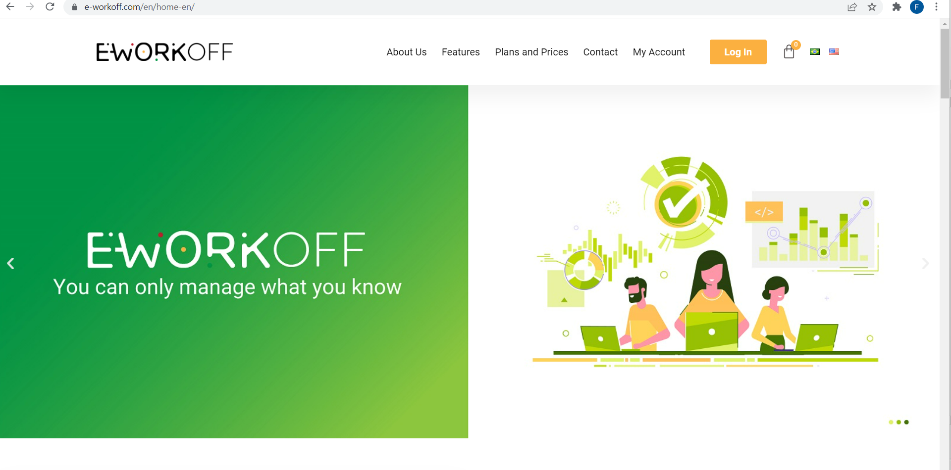

Slide 3
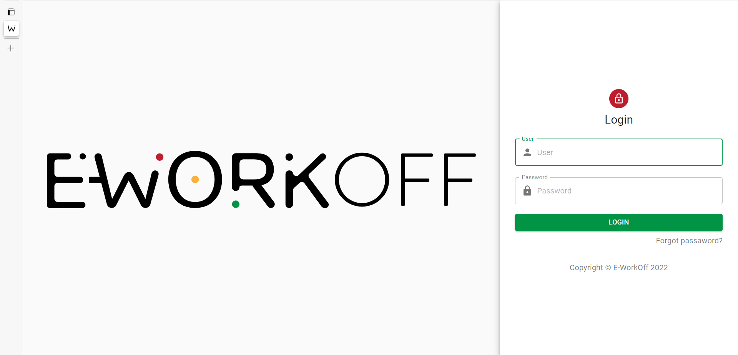
Fill out the fields “Username” and “Password” to login

Slide 4
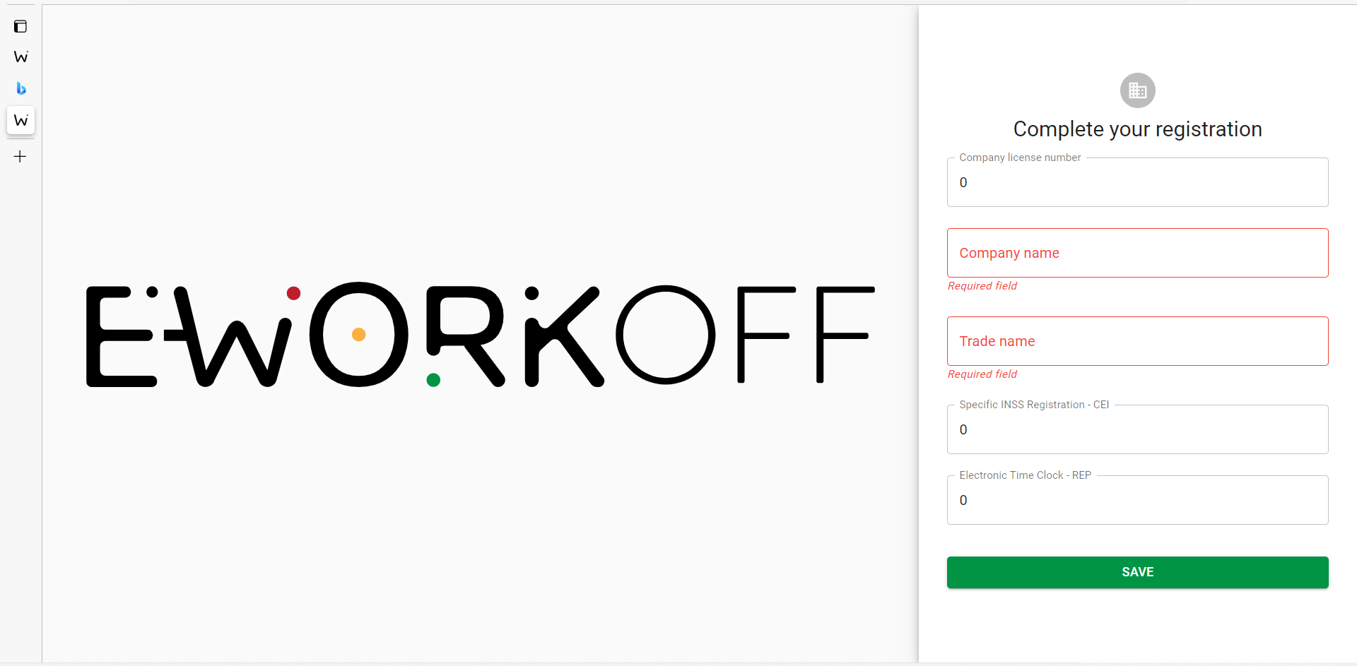

Slide 5
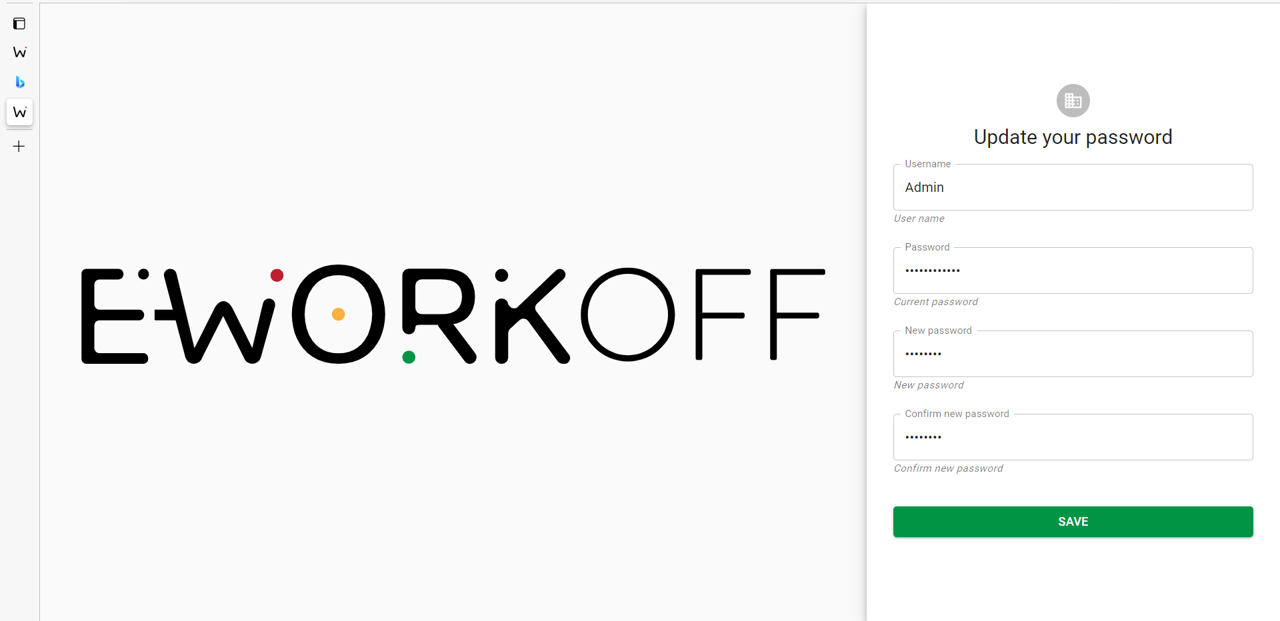

Slide 6
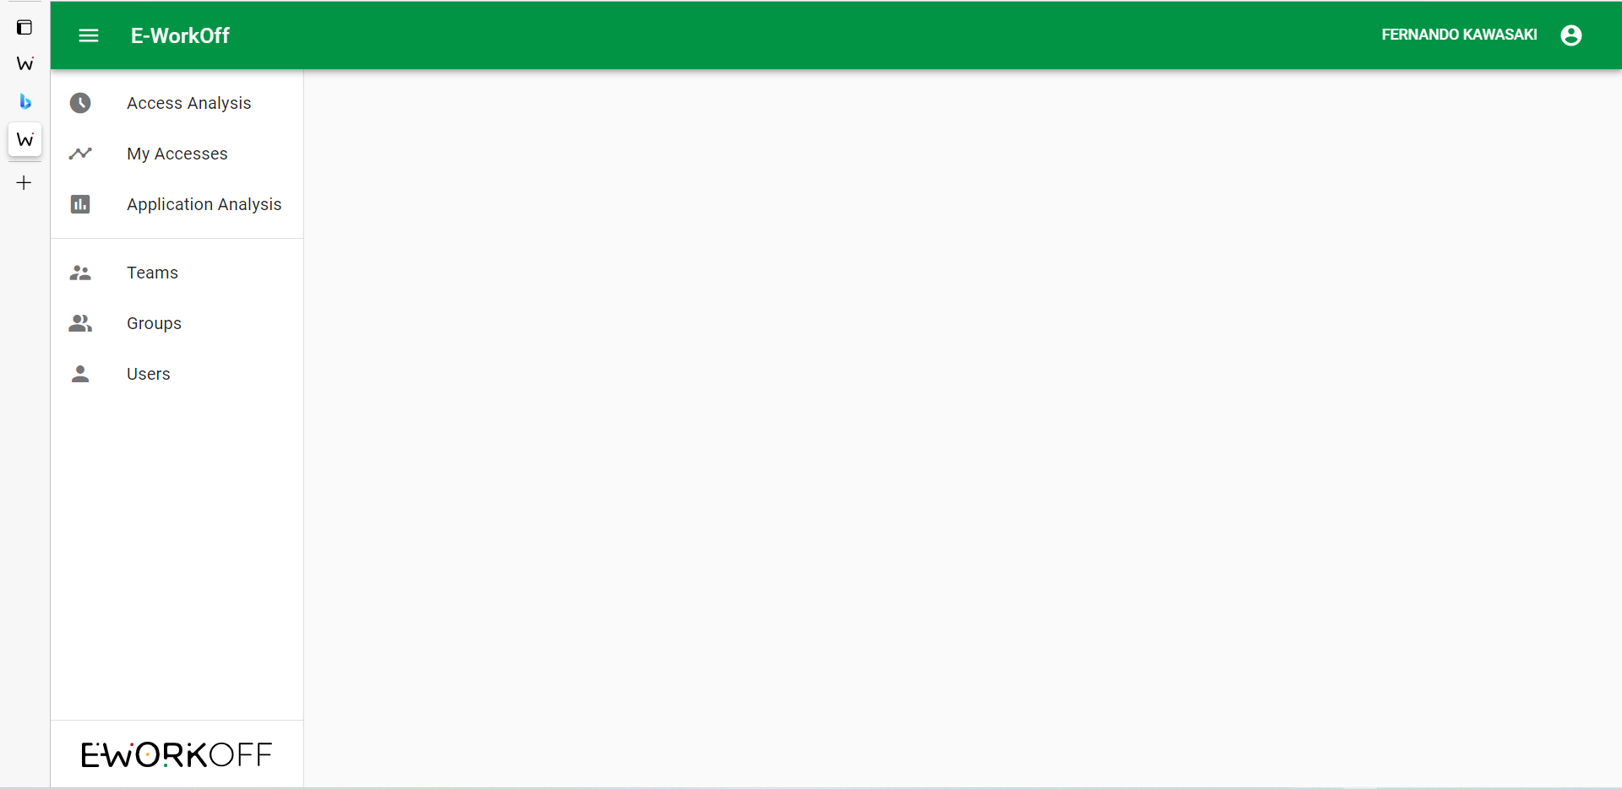

Slide 7
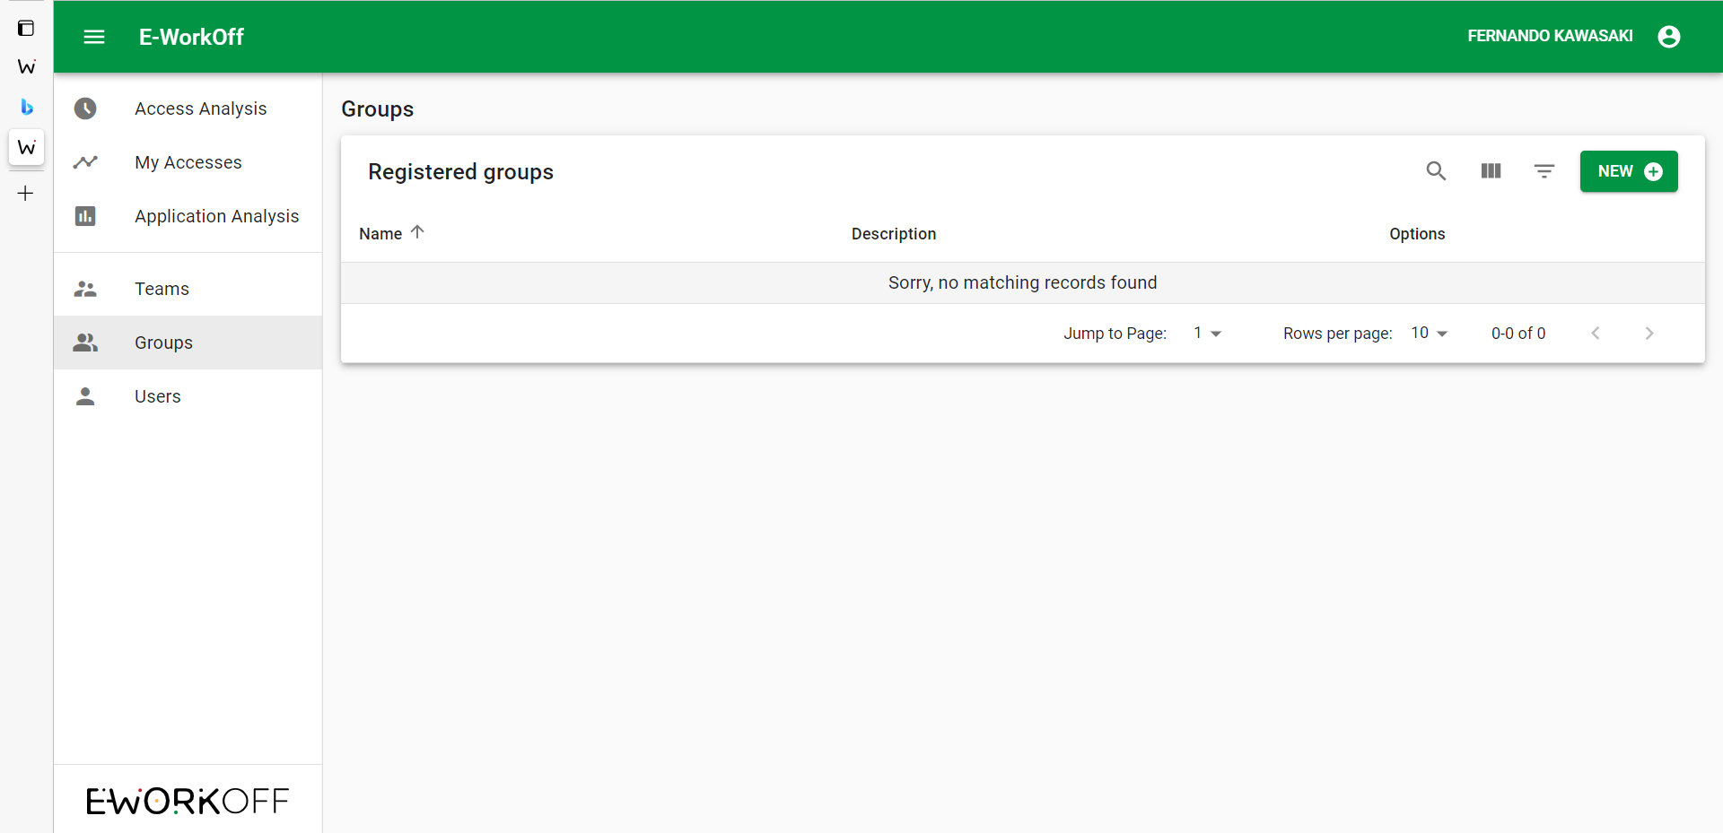
First, click “Groups” and then “New” to register new groups.

Slide 8
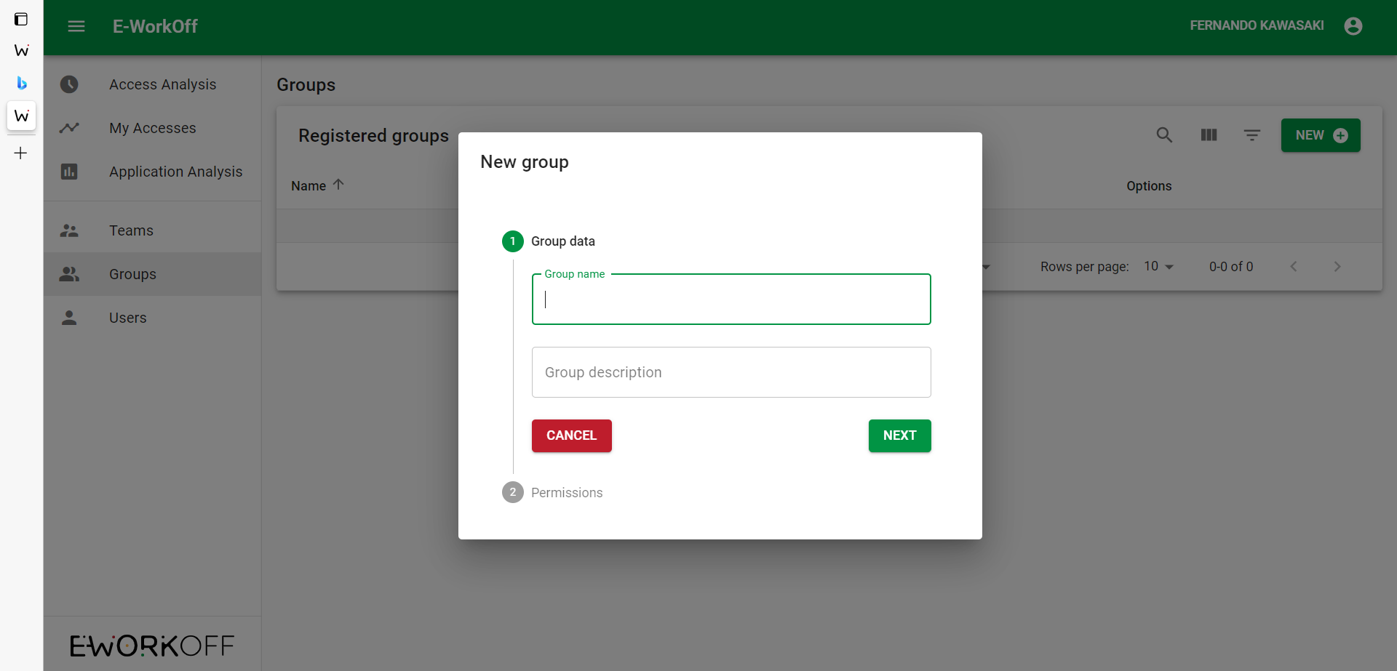
Fill out the fields: “Group Name” and “Group Description” and click on “next”.

Slide 9
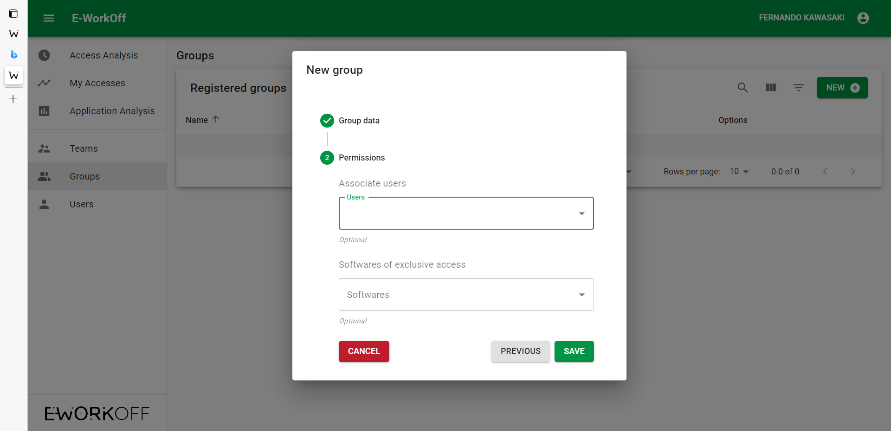
If you are starting to fill out the data through the “Groups” menu item, select only the Exclusive Access Software for this group.

Slide 10
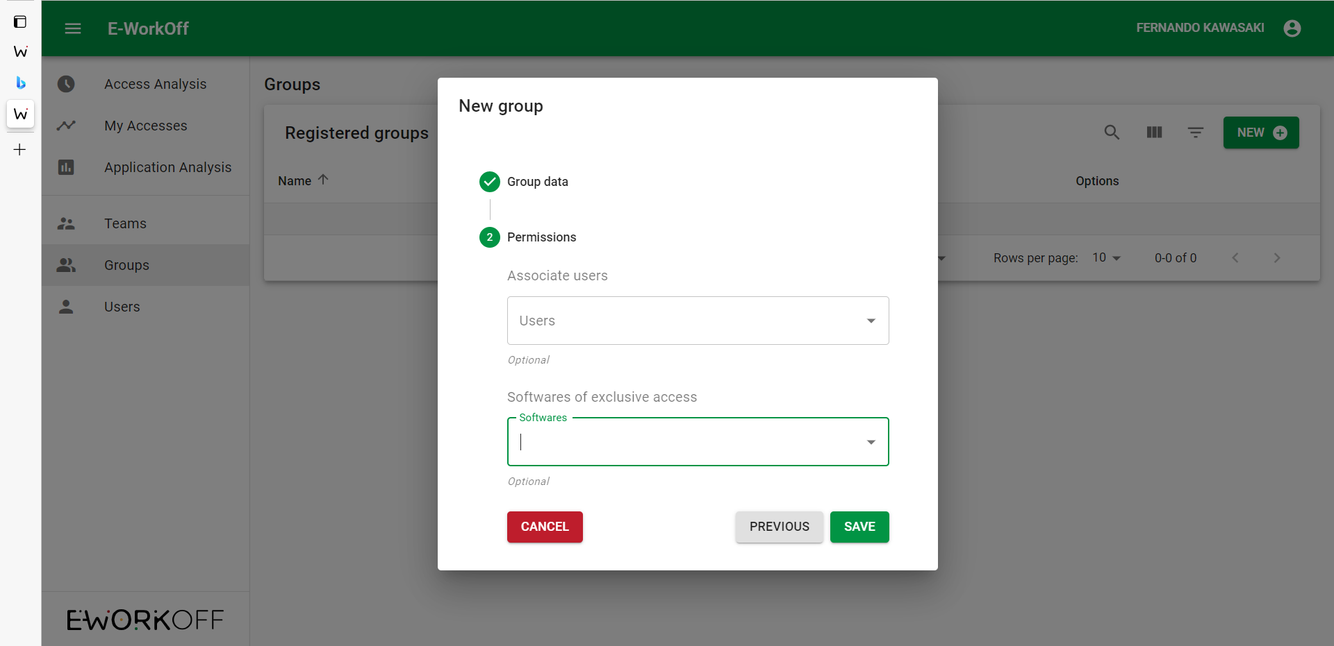
After selecting the software, click on save.

Slide 11
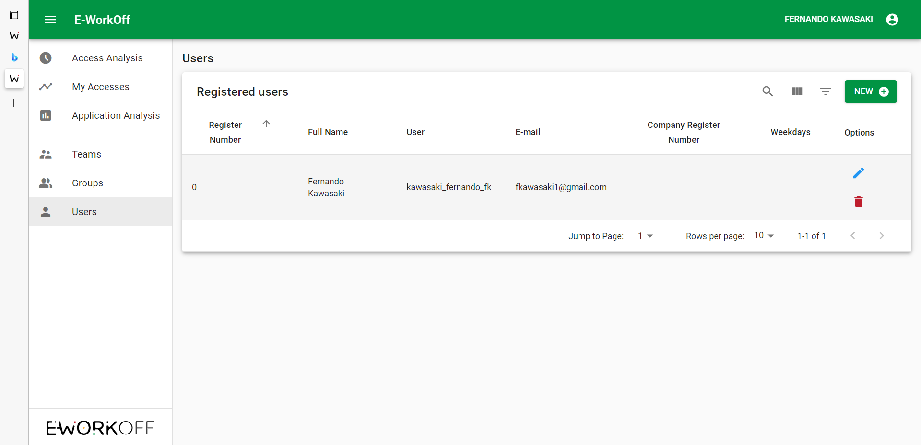
Adding users, first, click on "users" and then click on "new".

Slide 12
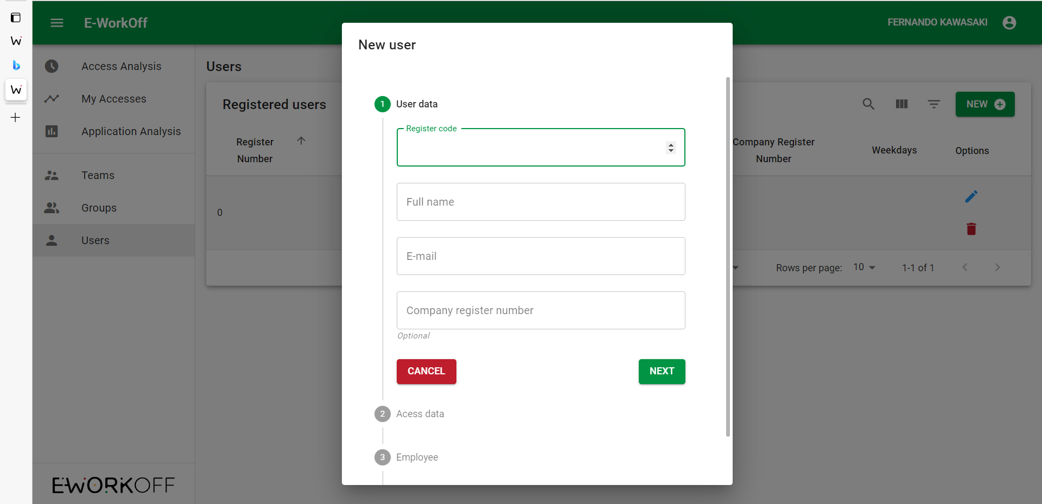
Fill out the fields with the employee's data and click on "next"

Slide 13
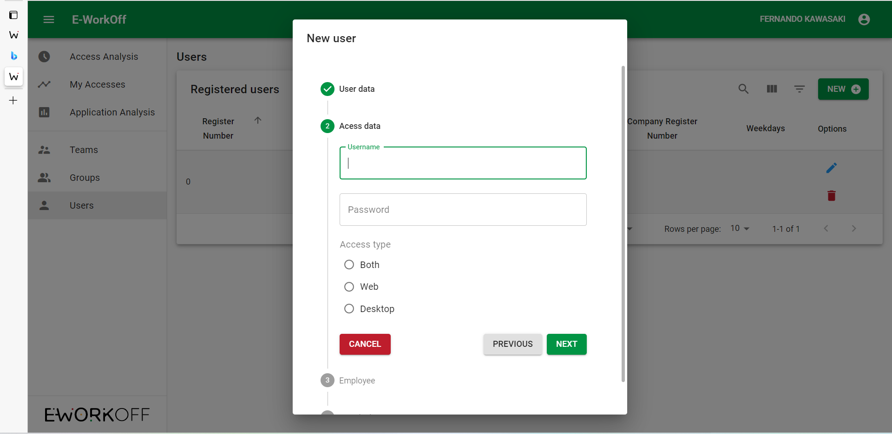
Register a username and password for the employee, click "Next".

Slide 14
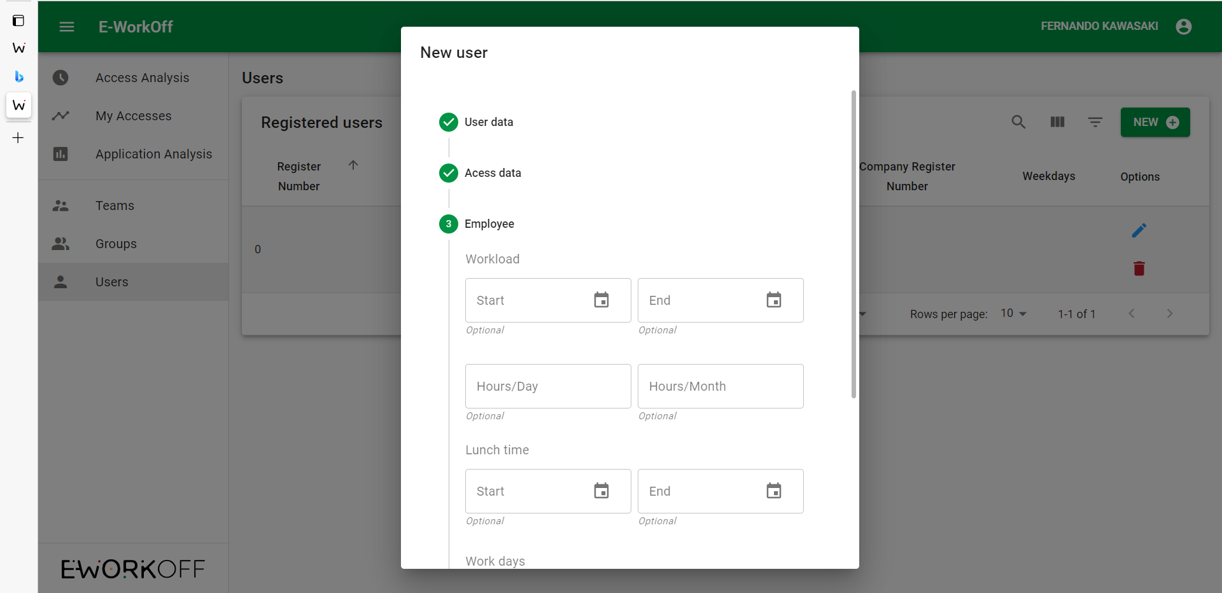
Set up the working hours

Slide 15
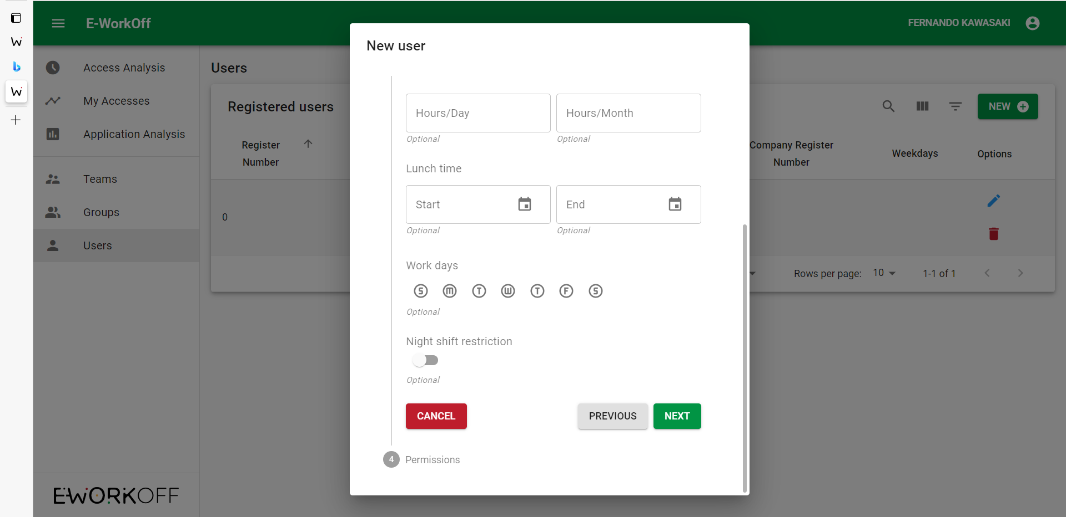
Set up the workdays and select if there will be a night shift, then click on “Next”.

Slide 16
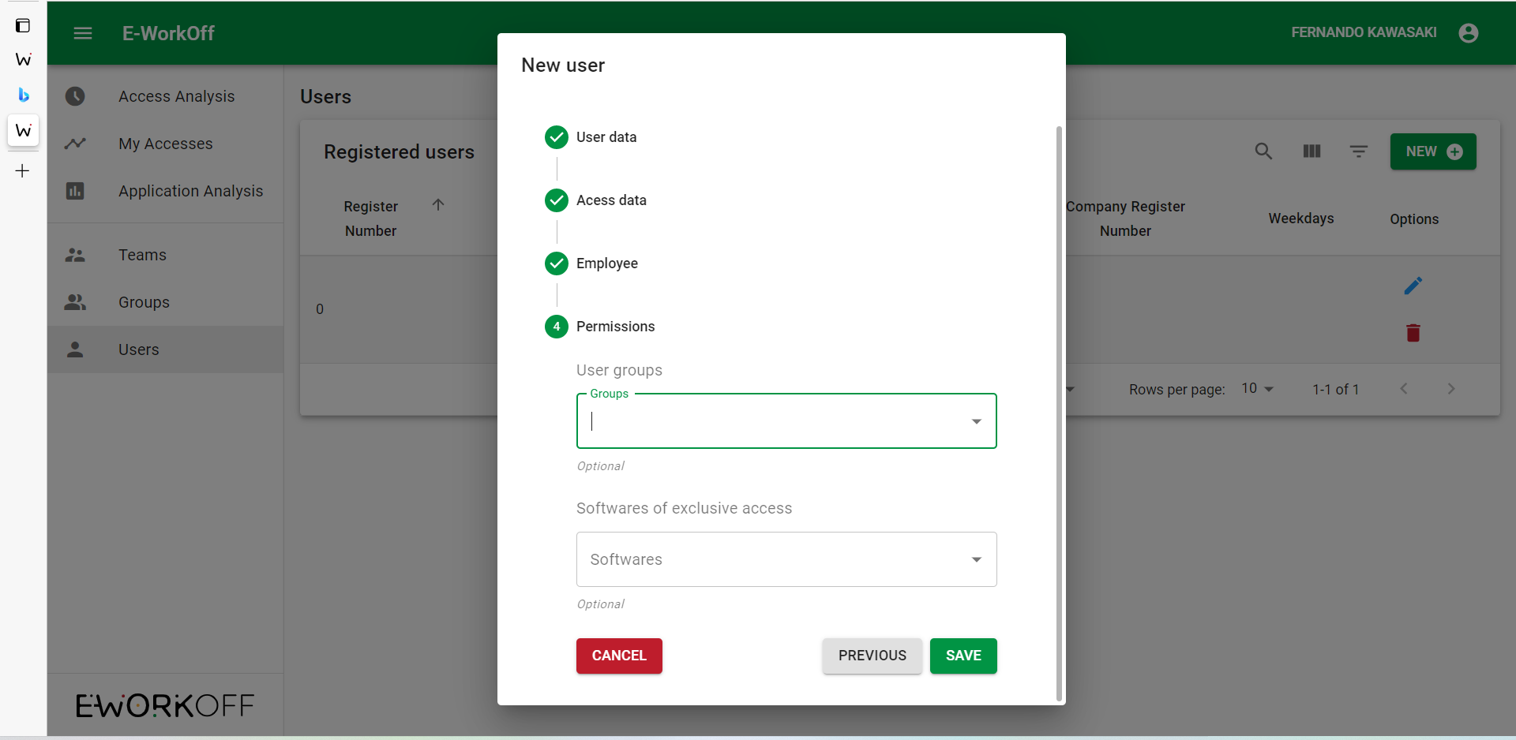
Select the group to which the employee belongs and the exclusive software access.

Slide 17
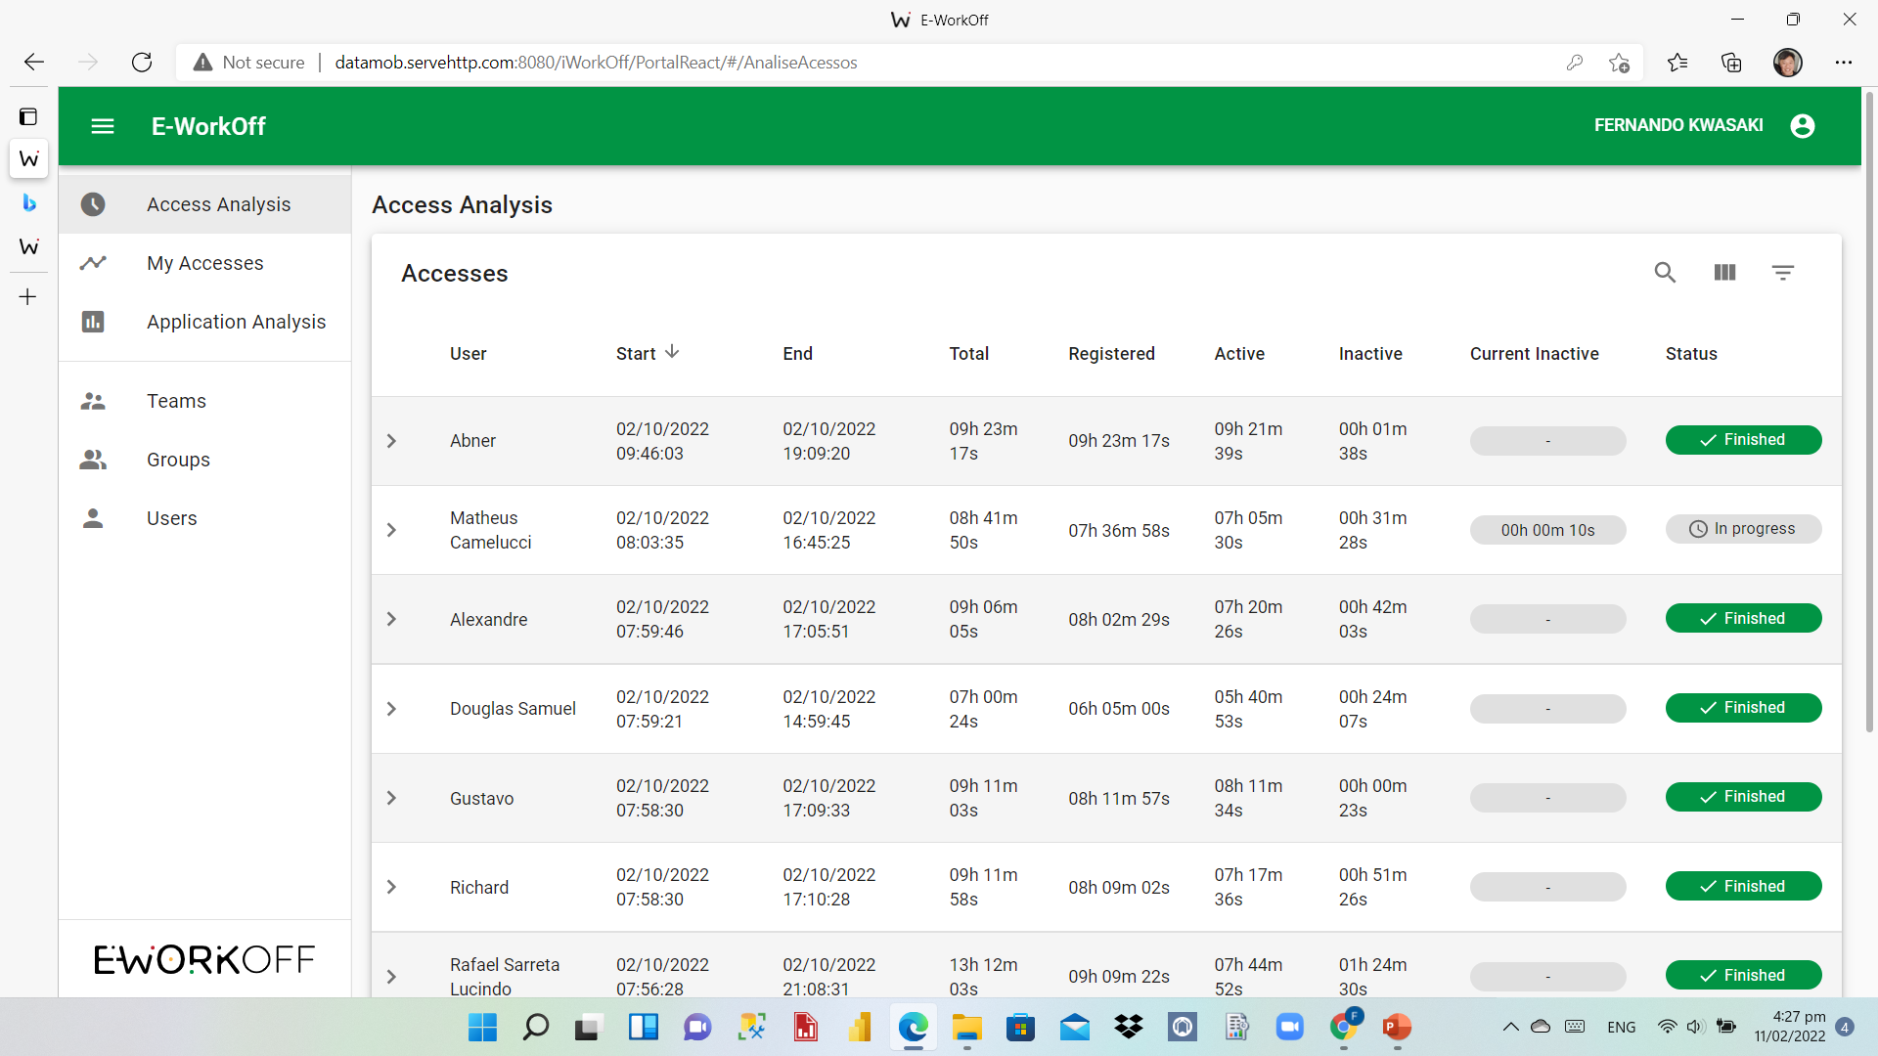
Employees management - click on “Access Analysis”

Slide 18
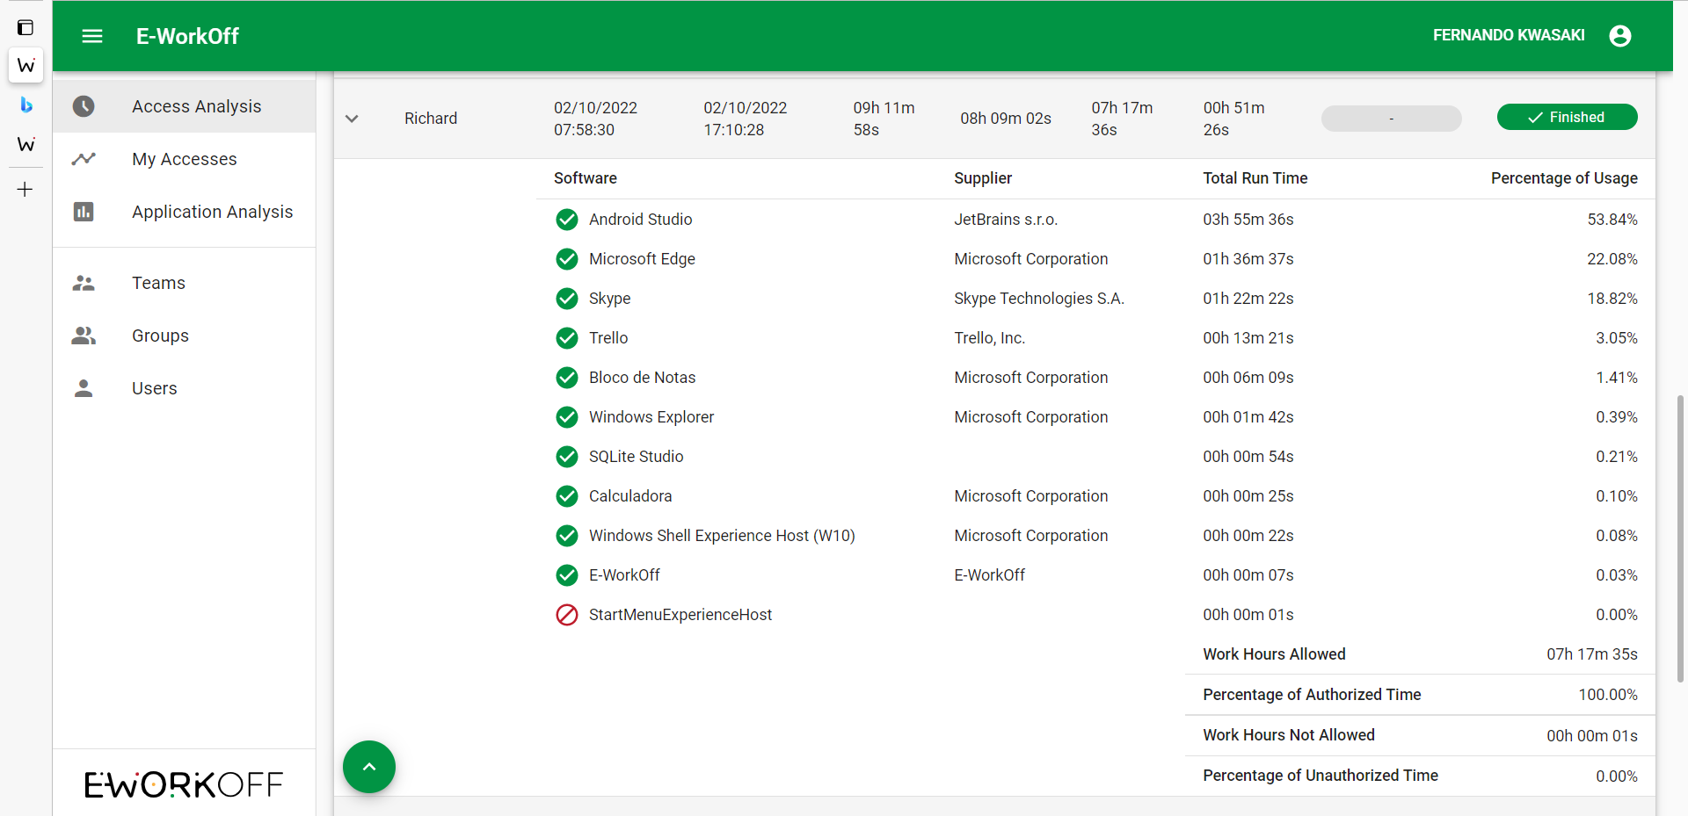
employee
For an accurate view of the employee's working hours, click on the name.

Slide 19
The red column marks the downtime of the employee. We customize the maximum downtime allowed according to the company's needs.

Slide 20
When an employee exceeds the allowed downtime, an alert is generated. The employee's name turns red and moves up to the top of the list.

Slide 21
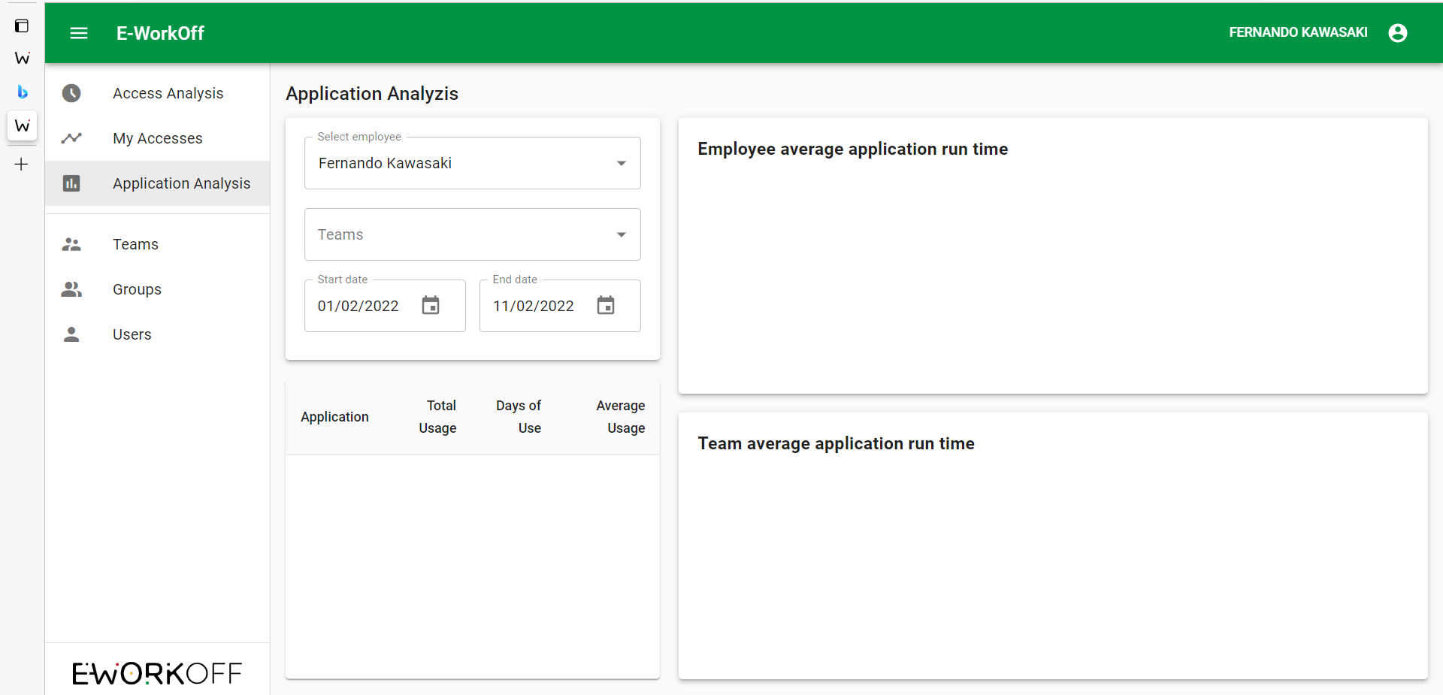
To view the applications accessed by the employee, first, click on “Applications Analysis” and then select the employee.

Slide 22
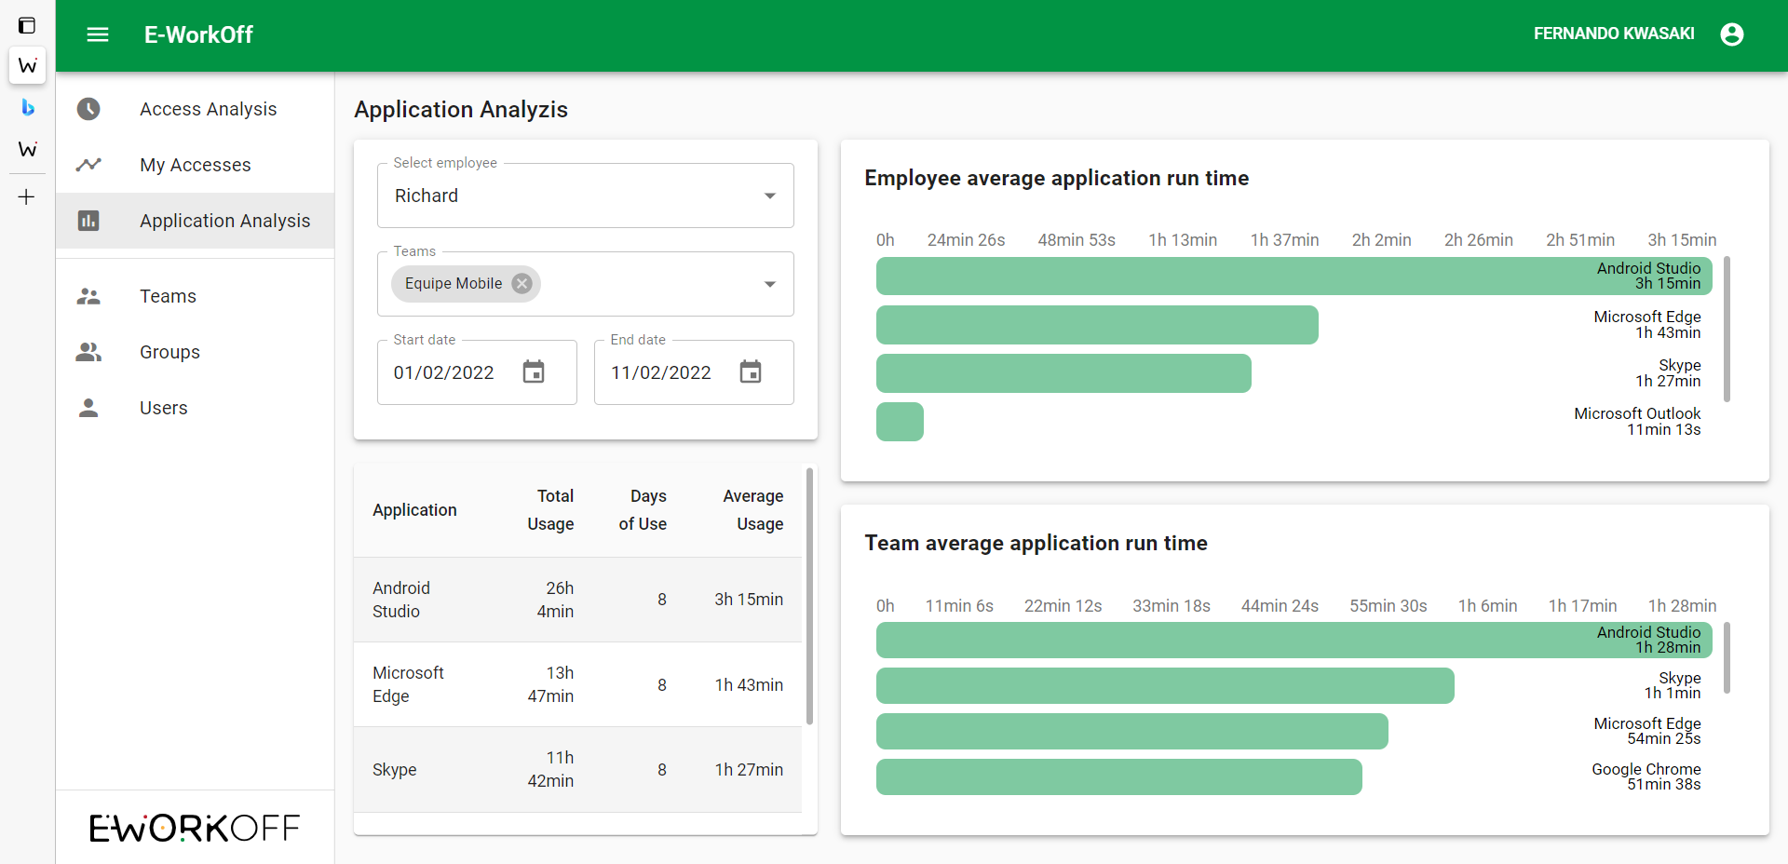

Slide 23
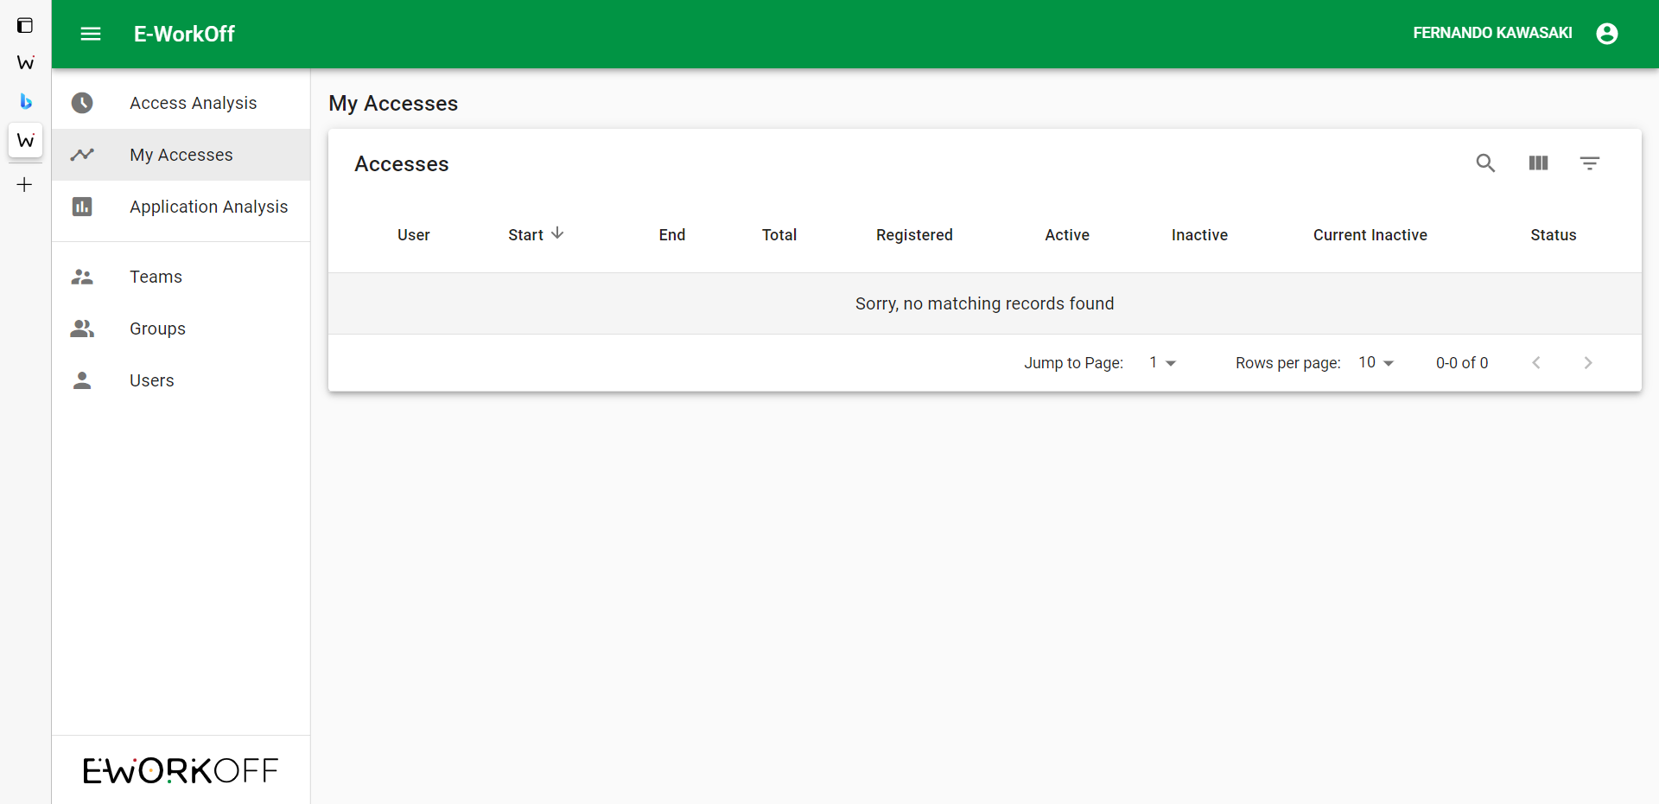
To view the administrator access, click on “My accesses”

Slide 24
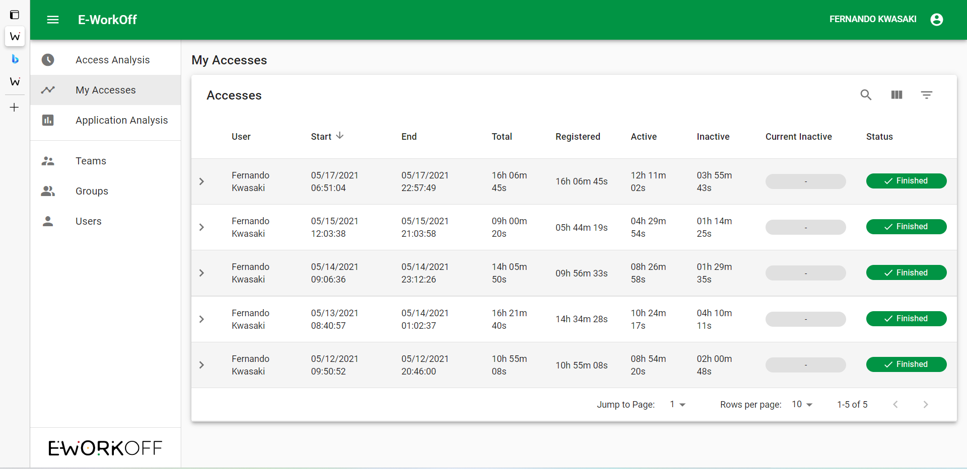

Slide 25
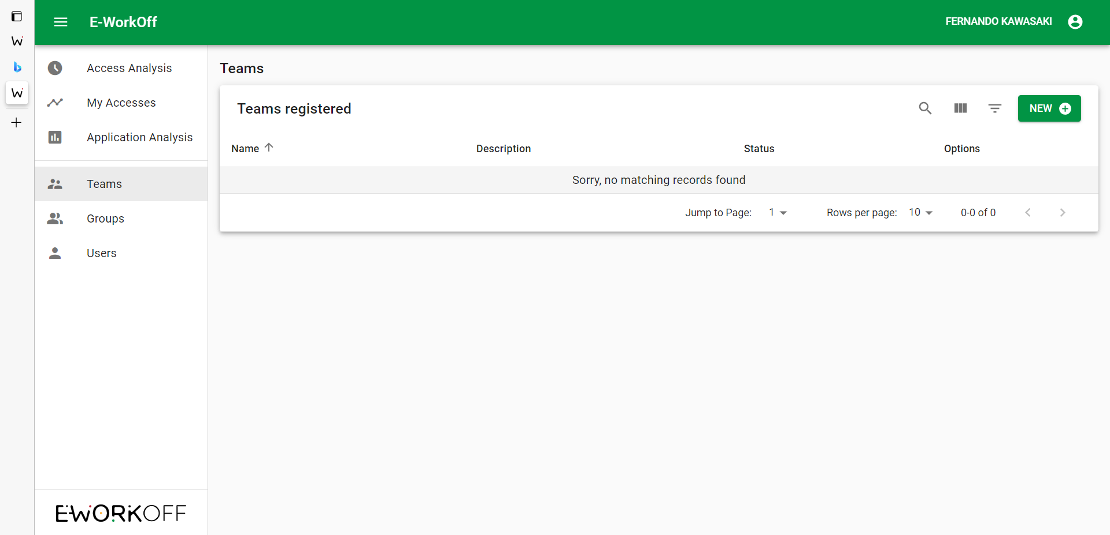
Click on “New” to create teams and then set up access which employees can view.
Important: for supervisors and management positions, the access type must be “Both” (Portal and Desktop).

Slide 27
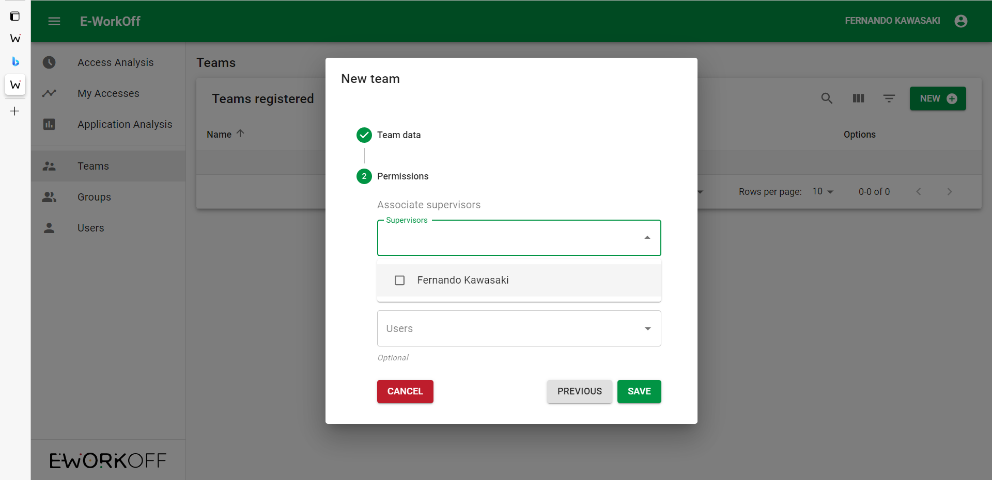

Slide 28
